Slide 1
XFLR5 Methods and Their Application in “Constraints on the Wing Morphology of Pterosaurs”
By: Colin Parker

Slide 2
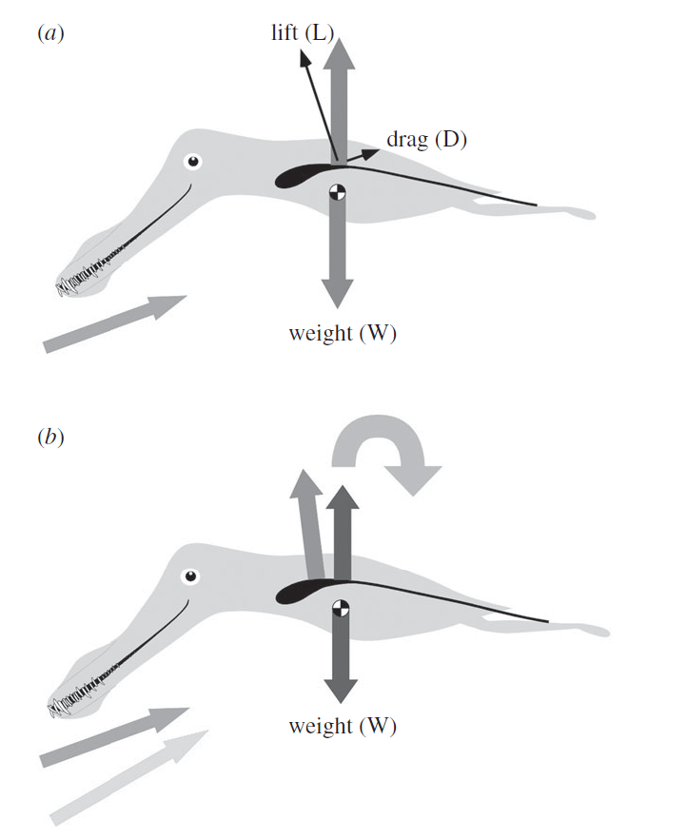
Longitudinal Stability Analysis

Slide 3
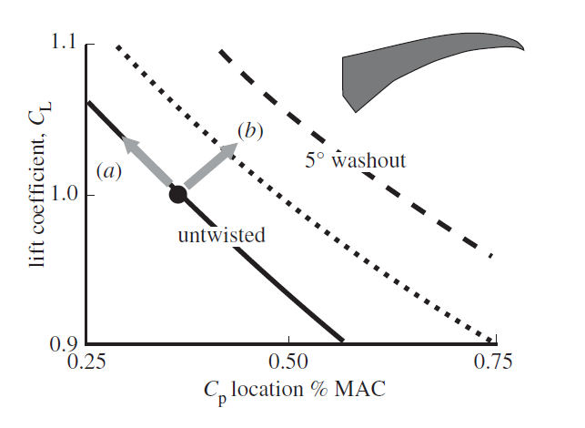
Effects of Washout

Slide 4
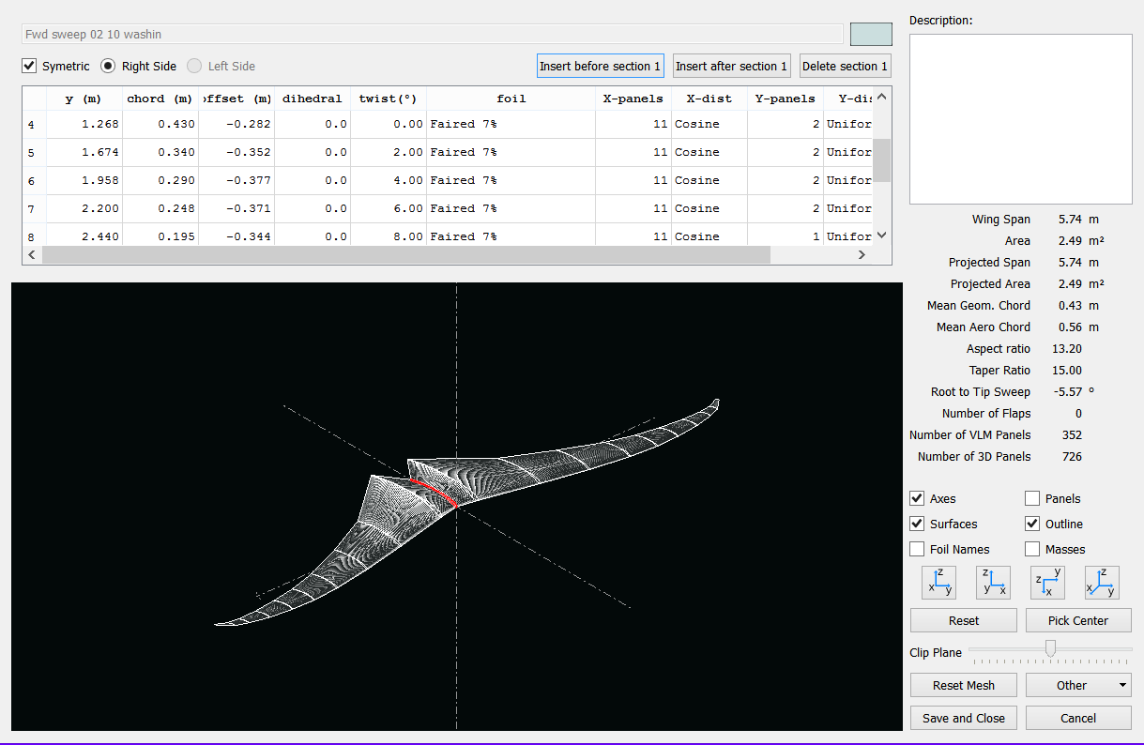
XFLR5

Slide 5
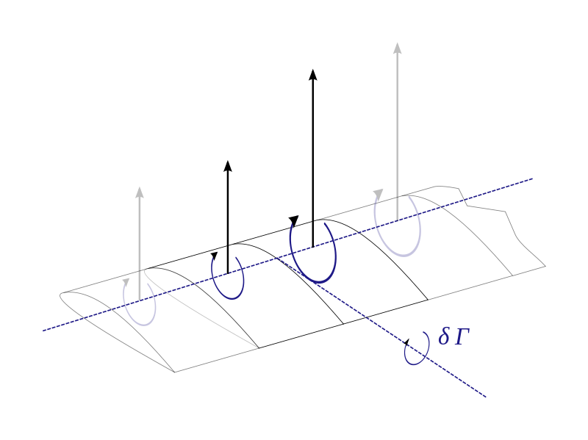
LLT Lifting Line Theory
Kutta_Joukowski
Biot-Savart
Helmholtz Theorem
The strength of a vortex filament is constant along its length
A vortex filament cannot end in a fluid: must extend to infinity or form a closed path
Effective angle of attack
Repeat

Slide 6
LLT
Limitations
Does not account for sweep
Does not account for dihedral
Inviscid
Must have high Aspect Ratio

Slide 7
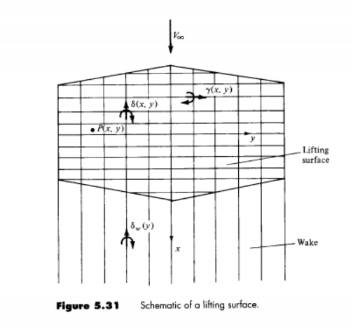
Lifting Surface Theory
Series of lifting lines
Circulation varies in both
Span wise lifting line
Chord wise vortices
Chord wise vortices extend into wake.
Biot-Savart
Flow tangency condition

Slide 8
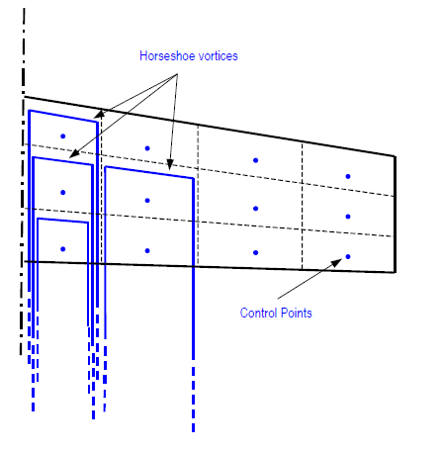
VLM Vortex Lattice Method
Assign circulation at control points
Biot-Savart Law
Flow tangency

Slide 9
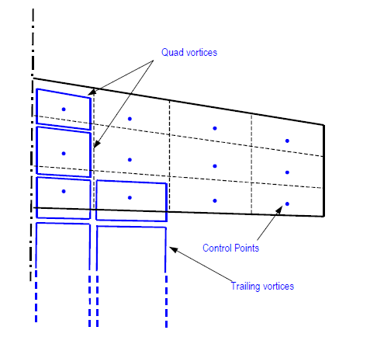
VLM2
Uses quad or ring vortices on surface
Uses horseshoe vortices on trailing edge to model wake
Biot-Savart has V~1/r^3 so difference in trailing vortices is typically minor

Slide 10
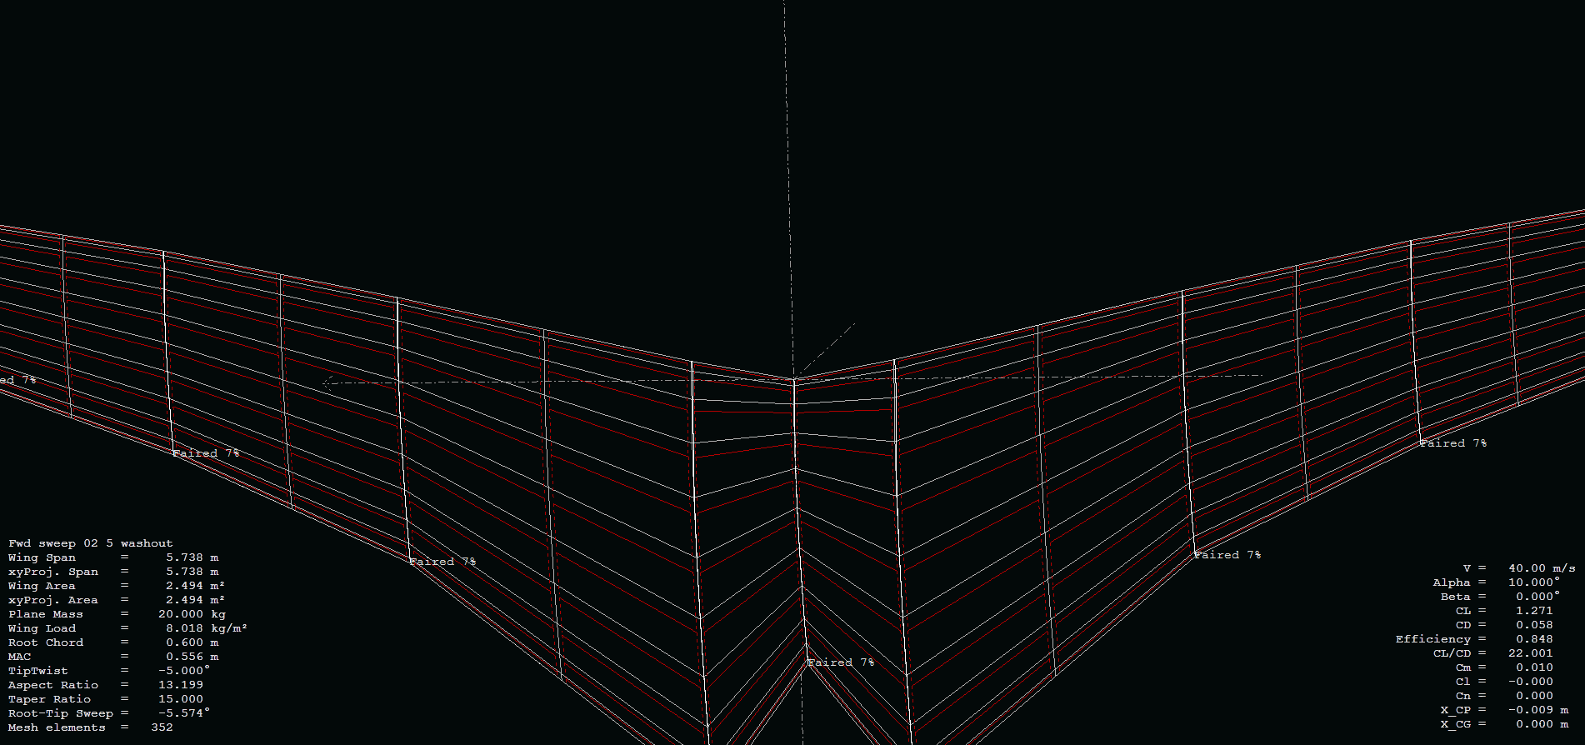
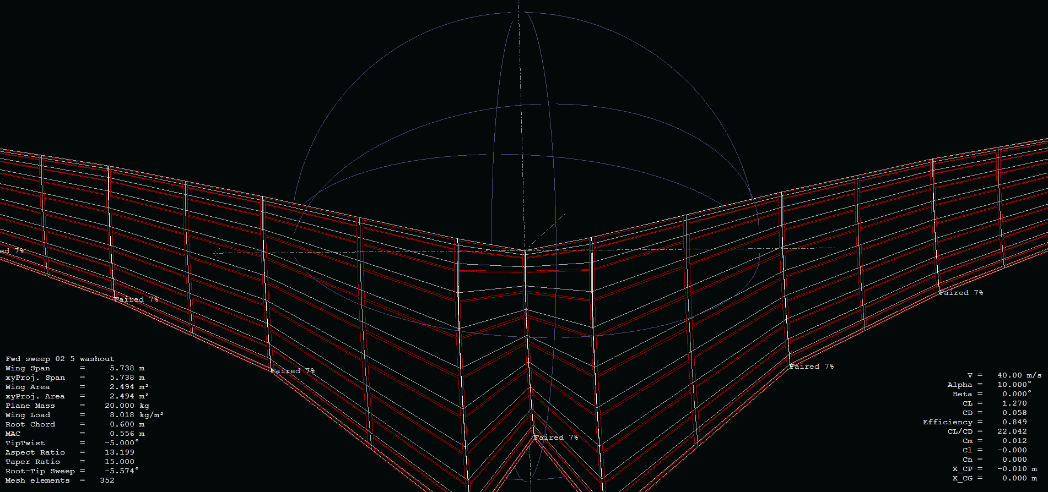

Slide 11
3D Panel Method

Slide 12
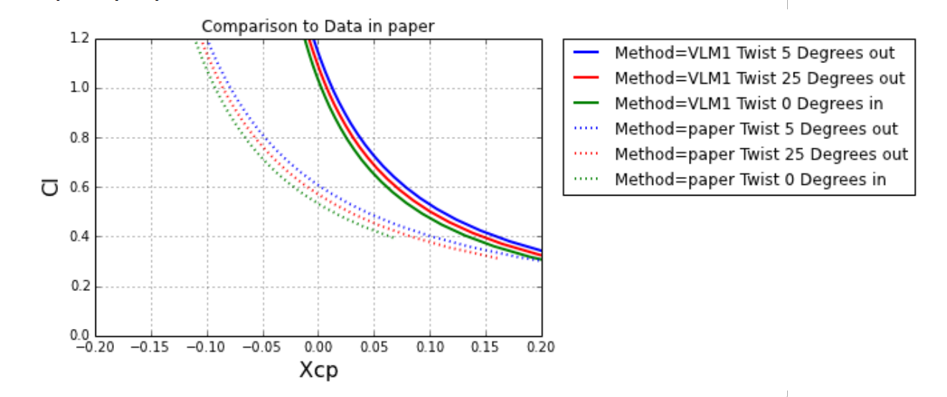

Slide 13
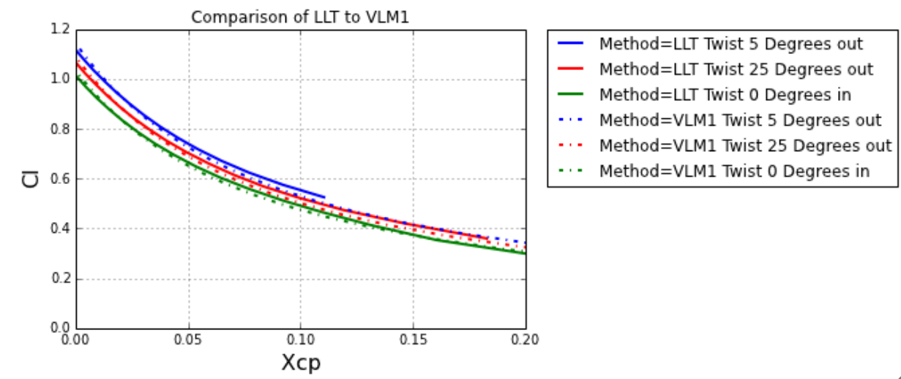

Slide 14
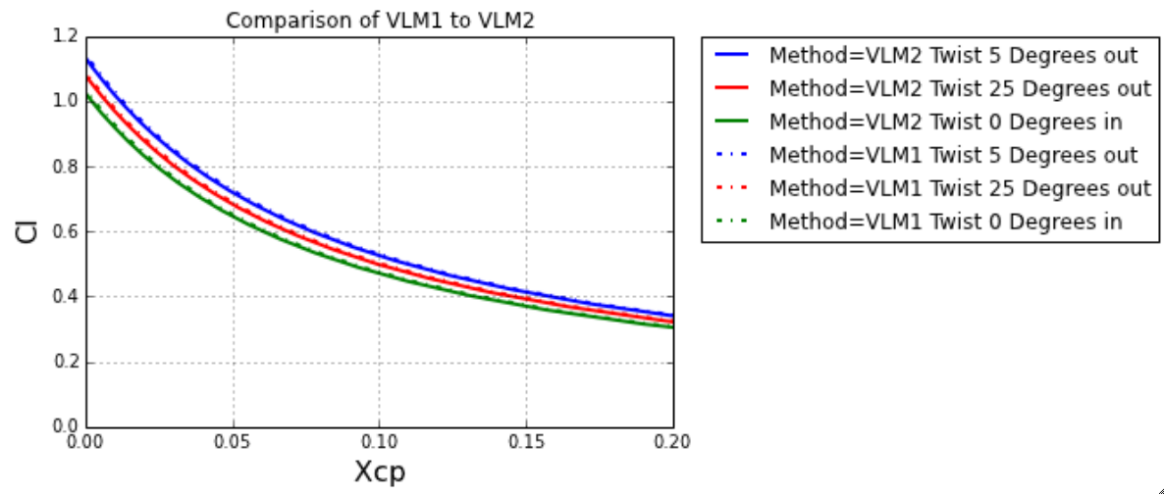

Slide 15
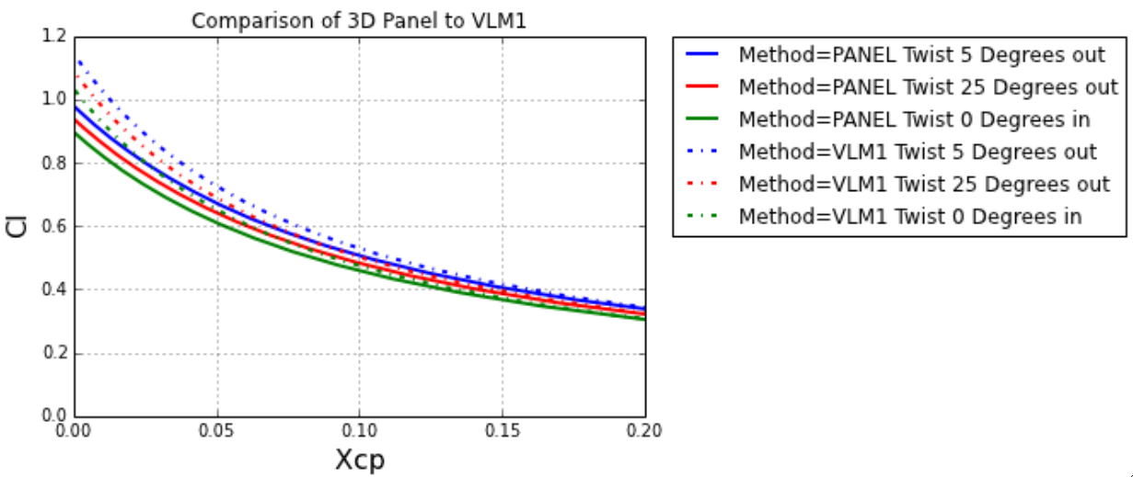

Slide 16
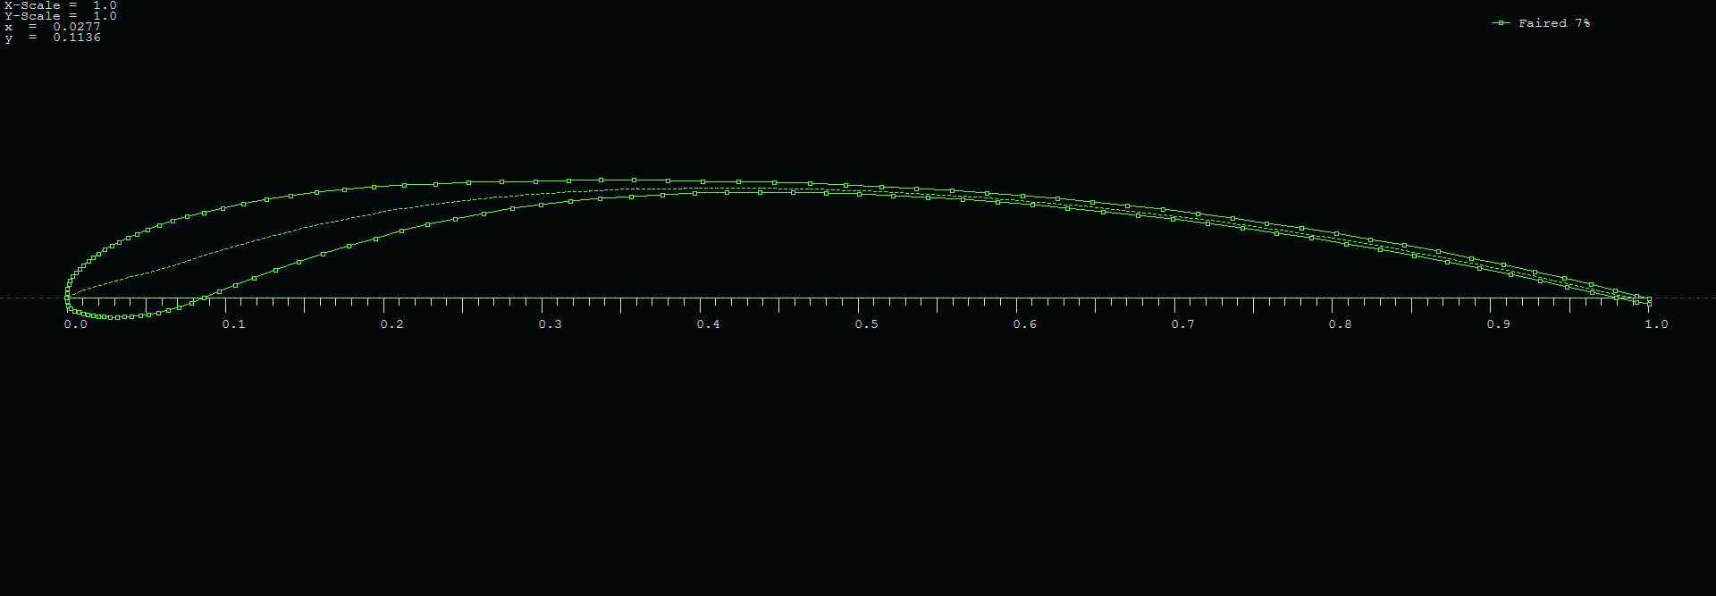
Airfoil Shape

Slide 17
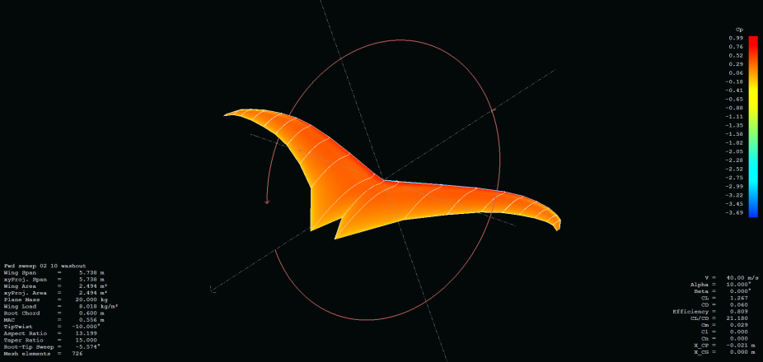
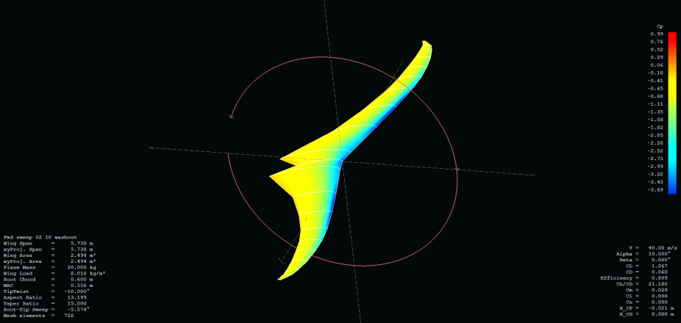
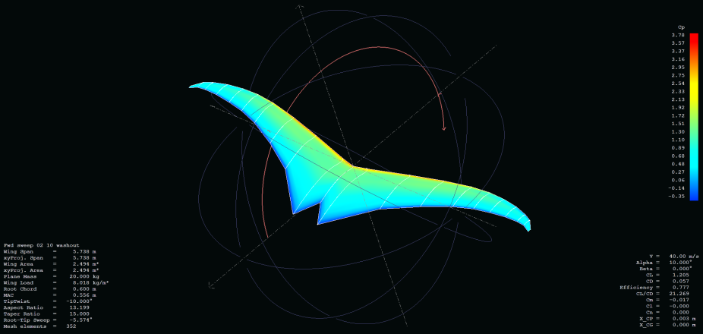
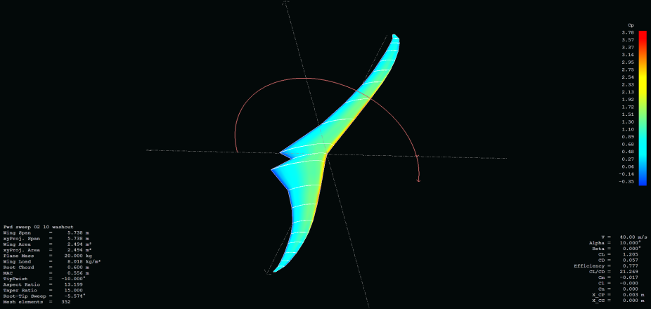
Cp Distribution
3D Panel
VLM1

Slide 18
Conclusions

Slide 19
Question?

